Slide 1


SocialBuzz
Analysis

Slide 2


Today's agenda
Project recap
Problem
The Analytics team
Process
Insights
Summary

Slide 3

taa
SocialBuzz, a rapidly expanding technology unicorn, seeks to swiftly adapt to its global scale. Accenture has initiated a three-month Proof of Concept (POC) centered around the following tasks:
Audit SocialBuzz Big Data Practice
Successful IPO launch recommendations
Analyse the top 5 performing topics
Project Recap

Slide 4


Problem
100,000+ posts per day
36,500,000 posts per year
How to handle huge traffic and data?
Find the top 5 performing topics.

Slide 5



Akhin Abraham
Data Analyst
The Analytics team
Marcus Rompton
Senior Principle
Andrew Flemming
Chief technical architect

Slide 6
Process
1
Data Understanding
2
Data Cleaning
3
Data Modeling
4
Data Analysis
5
Uncover Insights

Slide 7

Insights
Users enjoy the topics:
travel
science
healthy eating
animals
cooking
Users favourite type of post
photos
videos
GIFs
audio
Top reactions from users:
heart
scared
interested
indifferent
super love

Slide 8
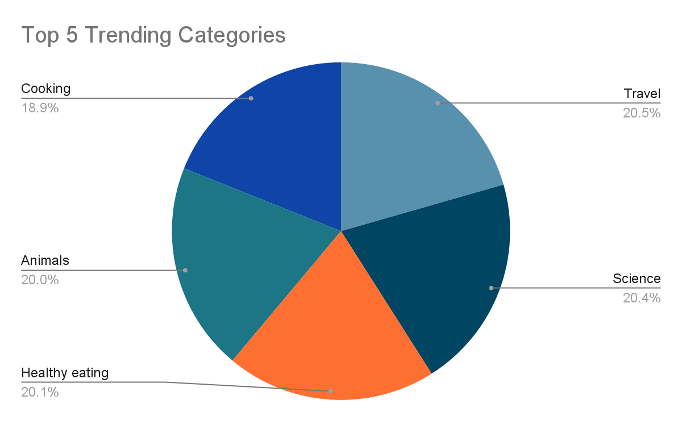

Slide 9
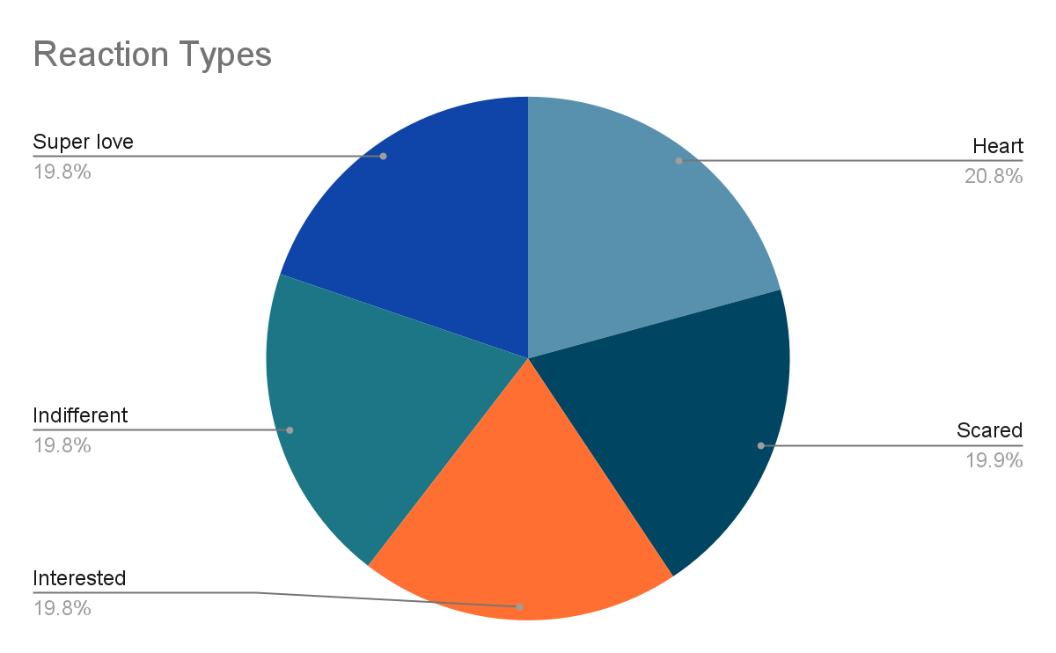

Slide 10

Most of the users are into travel, science, healthy eating, animals & cooking.
Users main go-to content type is image form posts.
Summary
SocialBuzz users are a mix of happy and scared people while seeing posts.

Slide 11

Thank you!
ANY QUESTIONS?

